Slide 1

Satellite communications
-Orbital Mechanics
Notes:
1
1

Slide 2
ORBITAL MECHANICS
Physical Laws
Requirements for Injection
Classifications of Orbit
Six Orbital Elements
Ground Tracks
Notes:
22
22

Slide 3
ORBITAL MECHANICS
Two men in history that were essential to formulating orbital mechanics:
Kepler and Newton!!
Kepler’s 3 Laws:
  Law of Ellipses
  Law of Equal areas
  Law of Harmonics
Newton’s 3 Laws:
  Law of Inertia
  Law of Momentum
  Law of Action -Reaction
Notes:
22
22

Slide 4
PHYSICAL LAWS
Kepler’s 1st Law: Law of Ellipses
The orbits of the planets are ellipses with the sun at one focus. Or, the orbits of satellites around the earth are ellipses with the earth at one focus…..
Notes:
10
10

Slide 5

PHYSICAL LAWS
Is this orbit possible?
Notes:
12
12

Slide 6
PHYSICAL LAWS
Kepler’s 2nd Law: Law of Equal Areas
The line joining the planet to the center of the sun sweeps out equal areas in equal times
T4
T5
T3
T2
A4
A3
T1
A5
A2
A1
T6
A6
Notes:
13
13

Slide 7
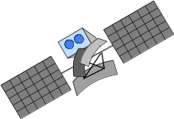
PHYSICAL LAWS
Kepler’s 2nd Law: Law of Equal Areas
Satellites travel at the same speed!!
Notes:
14
14

Slide 8
PHYSICAL LAWS
Kepler’s 2nd Law: Law of Equal Areas
t2
t1
Area 2
Area 1
t0
t3
t1-t0 = t3-t2
Area 1 = Area 2
Satellites travel at varying speeds!!
Notes:
15
15

Slide 9
PHYSICAL LAWS
Kepler’s 3rd Law: Law of Harmonics
The squares of the periods of two planets’ orbits are proportional to each other as the cubes of their semi-major axes:
T1²/T2² = a1³/a2³
In English:
Orbits with the same semi-major axis will have the same period
Notes:
16
16

Slide 10
PHYSICAL LAWS
Sir Isaac Newton
Derived three laws of motion
Derived the Law of Universal Gravitation
Explained why Kepler’s laws worked
Notes:
17
17

Slide 11
PHYSICAL LAWS
Newton’s 1st Law: Law of Inertia
Every body continues in a state of uniform motion unless it is compelled to change that state by a force imposed upon it
Notes:
18
18

Slide 12
PHYSICAL LAWS
Newton’s 2nd Law: Law of Momentum
Change in momentum is proportional to and in the direction of the force applied
Momentum equals mass x velocity
Change in momentum gives: F = ma
F
F
Notes:
19
19

Slide 13
PHYSICAL LAWS
Newton’s 3rd Law: Action - Reaction
For every action, there is an equal and opposite reaction
Hints at conservation of momentum
Notes:
20
20

Slide 14
INJECTION REQUIREMENTS
Speed
If you want something to stay in an orbit, it has to be going very fast!
Notes:
23
23

Slide 15
INJECTION REQUIREMENTS
Speed
5 m
8 km
Notes:
24
24

Slide 16
INJECTION REQUIREMENTS
Speed
A satellite must be going 17,500 mph to stay in a low earth orbit
17,500 mi/hr
100 miles
Notes:
25
25

Slide 17
INJECTION REQUIREMENTS
Altitude
Are you moving FASTER or SLOWER the higher your altitude?
Notes:
26
26

Slide 18
INJECTION REQUIREMENTS
Direction
Since the earth rotates from west to east, you want to
launch satellites to the east
This give you a 915 mph speed boost by launching east
(at the Kennedy Space Center’s location in Florida)
What happens if you launch to the west? The south?
Notes:
29
29

Slide 19
ORBITAL ELEMENTS
Definition
A set of mathematical parameters that enables us to accurately describe satellite motion
Notes:
59
59

Slide 20
ORBITAL ELEMENTS
Purpose
Discriminate one satellite from other satellites
Predict where a satellite will be in the future or has been in the past
Determine amount and direction of maneuver or perturbation
Notes:
60
60

Slide 21
ORBITAL ELEMENTS or
The Six Keplerian Elements
Size/Period
Shape (Circular or Ellipse)
Inclination
Right Ascension
Argument of Perigee
True Anomaly
Notes:
31
31

Slide 22
ORBIT CLASSIFICATION
Size/Period
Size is how big or small your satellite’s orbit is….
Defined by semi-major axis
There are basically 4 sizes of orbits satellites use:
  Low Earth Orbit (LEO): approx 120 – 1200 miles above Earth
  Medium Earth Orbit (MEO) or Semi-synchronous Orbit: approx 12,000 miles above Earth
  Highly Elliptical Orbit (HEO): altitude varies greatly! From 100 miles to sometimes several hundred thousand miles
  Geo-synchronous or Geo-stationary Orbit
  (GEO): approx 22,300 miles from Earth
Notes:
32
32

Slide 23
ORBIT CLASSIFICATION
Location of Orbits
Equatorial – Prograde (towards the east) or Retrograde (towards the west)
Polar – Over the Poles!!
A very Important Point:
ALL ORBITS OF SATELLITES MUST INTERSECT THE CENTER OF THE EARTH
Notes:
33
33

Slide 24
ORBIT CLASSIFICATION
Shape
Orbit shapes are either
circular or not circular:
some sort of an
Ellipse!!
How elliptical an orbit, is called Eccentricity
Notes:
34
34

Slide 25
ORBIT CLASSIFICATIONS
Circular Orbits
Characteristics
  Constant speed
  Nearly constant altitude
Typical Missions
  Reconnaissance/Weather (DMSP)
  Manned
  Navigational (GPS)
  Geo-synchronous (Comm sats)
Notes:
36
36

Slide 26
ORBIT CLASSIFICATIONS
Elliptical Orbits
Characteristics
  Varying speed
  Varying altitude
  Asymmetric Ground Track
Typical Missions
  Deep space surveillance (Pioneer)
  Communications (Polar comm.)
  Ballistic Missiles
Notes:
37
37

Slide 27
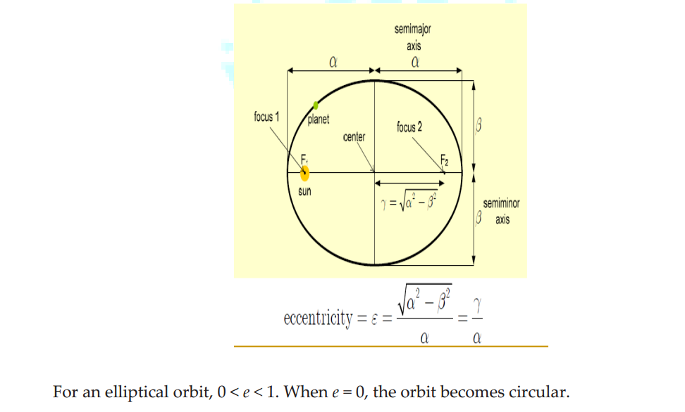
Eccentricity

Slide 28
ORBIT CLASSIFICATIONS
Eccentricity
e = 0.75
The closer your Eccentricity is to 1, the more elliptical your orbit is
e = .45
e = 0
Why could you never have an Eccentricity of 1??
Notes:
42
42

Slide 29
ORBITAL ELEMENTS
Inclination
Inclination is the tilt of your orbit
  At 0 degrees of inclination, you are orbiting the equator
  At 90 degrees of inclination, you are in a polar orbit
Equatorial Plane
Inclination: Is this angle, measured in degrees
Inclination
Orbital Plane
Notes:
62
62

Slide 30
ORBITAL ELEMENTS
Inclination
Prograde: 0 ≤ i < 90
Equatorial: i = 0 or 180
Retrograde: 90 < i ú 180
Polar: i = 90
Notes:
67
67

Slide 31
ORBITAL ELEMENTS
Right Ascension
Right Ascension is the swivel of your tilt, as measured from
a fixed point in space, called the First Point of Aries
i
Line of Nodes
First Point of Aries ()
Right Ascension of the Ascending Node (Ω)
Notes:
63
63

Slide 32
ORBITAL ELEMENTS
Right Ascension
Right Ascension will determine where your satellite will
cross the Equator on the ascending pass
It is measured in degrees
Inclination
You will be able to much easily see what Right Ascension is when using STK!!
Line of Nodes
First Point of Aries ()
Right Ascension is this angle, measured in degrees
You will not have a Right Ascension if your Inclination is 0, why?
Notes:
63
63

Slide 33
ORBITAL ELEMENTS
Argument of Perigee
Argument of Perigee is a measurement from a fixed point
in space to where perigee occurs in the orbit
It is measured in degrees
Perigee
Argument of Perigee: Is this angle, measured in degrees
You will be able to much easily see what Argument of Perigee is when using STK!!
Inclination
Apogee
Line of Nodes

Ω
Notes:
64
64

Slide 34
ORBITAL ELEMENTS
True Anomaly
True Anomaly is a measurement from a fixed point in space to
the actual satellite location in the orbit
It is measured in degrees
True Anomaly: Is this angle, measured in degrees
Direction of satellite motion
You will be able to much easily see what True Anomaly is when using STK!!
Fixed point in space
Notes:
65
65

Slide 35
GROUND TRACKS!!
Notes:
2
2

Slide 36
GROUND TRACKS
Definition
One way to define a satellite’s orbit is to determine its track across the ground
It is as if you had a big pencil from the satellite to the ground. The track it traces is called the ground track
Notes:
2
2

Slide 37
GROUND TRACKS
Definition
Sub point
  Point on Earth’s surface defined by an imaginary line connecting the satellite and the Earth’s center
Ground Track
  Trace of sub points over time
Notes:
2
2

Slide 38
GROUND TRACKS
Factors
Size/Period
Eccentricity
Inclination
Argument of Perigee
Injection Point
Notes:
3
3

Slide 39
Ground Tracks
Period
- For a non-rotating Earth, the ground
track of a satellite is a great circle
- Since the Earth spins on its axis and the
satellite orbits the Earth, the period of both
affects the ground track
Notes:
4
4

Slide 40
Ground Tracks
Westward Regression
- Earth rotates east under a satellite => satellite
appears to walk west
- Earth rotates 360 degrees in 24 hours
(15 degrees per hour)
Notes:
5
5

Slide 41

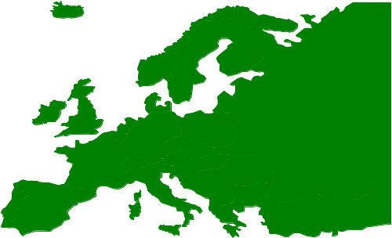




Ground Tracks
Westward Regression
C
B
A
-120
-90
-60
-30
0
30
60
A - time zero
B - after one orbit
C - after two orbits
Notes:
6
6

Slide 42
Ground Tracks
Eccentricity
Highly eccentric orbit means satellite moves faster at perigee and slower at apogee => ground track will be asymmetrical
Satellite will ‘hang’ over earth at apogee and move faster than the earth at perigee
Notes:
7
7

Slide 43
Ground Tracks
Eccentricity
Ground Track for Molnyia orbit
eccentricity = .7252
Notes:
8
8

Slide 44
Ground Tracks
Inclination
Inclination of the orbit determines the maximum latitude the ground track will reach
Notes:
15
15

Slide 45
Ground tracks
Inclination
60
30
45N
0
30
60
45S
Inclination = 45 degrees
Eccentricity ~ 0
Notes:
16
16

Slide 46
Ground Tracks
Argument of Perigee
- Establishes the longitude of both perigee and apogee
Direction of
satellite motion
perigee
Argument of Perigee angle
ascending node
apogee
line of nodes
Notes:
17
17

Slide 47
Ground tracks
Argument of Perigee
Argument of Perigee ~ 90 degrees (red)
argument of perigee ~ 270 degrees (white)
Notes:
18
18

Slide 48
Ground tracks
Injection Point
Assuming no maneuvers after launch, launch sites will determine inclination - more on this in launch considerations
Injection point will determine where the ground track will start
Notes:
19
19

Slide 49
PERTURBATIONS
Space is a vacuum
Once a satellite is in orbit, in the vacuum of
space, is there anything that will affect it??
Yes – these things are called
Perturbations…….
Notes:
23
23

Slide 50
PERTURBATIONS
Definition
  A disturbance in the regular motion of a celestial body
Types
  Gravitational
  Atmospheric Drag
  Third Body Effects
  Solar Wind/Radiation Effects
  Electro-magnetic
Notes:
23
23

Slide 51
PERTURBATIONS
Gravitational
Earth’s asymmetrical mass causes a non-central gravitational pull
Notes:
24
24

Slide 52
PERTURBATIONS
Gravitational
Ellipticity of the Earth causes gravity wells and hills
Stable points: 75E and 105W
-- Himalayas and Rocky Mountains
Unstable points: 165E and 5W
-- Marshall Islands and Portugal
Drives the requirement for station keeping
Notes:
29
29

Slide 53
PERTURBATIONS
Atmospheric Drag
Friction caused by impact of satellite with particles in the Earth’s atmosphere
Reduces satellite’s energy
Changes the size (semi-major axis) and shape (eccentricity)
Notes:
30
30

Slide 54

PERTURBATIONS
Atmospheric Drag
Perigee remains same, Apogee decreases
Notes:
31
31

Slide 55
PERTURBATIONS
Third Body Effects
Gravitational pull of other massive bodies, i.e. Sun, moon
Mainly noticeable in deep space orbits
Notes:
32
32

Slide 56
PERTURBATIONS
Solar Wind/Radiation Pressure
Solar wind causes radiation pressure on the satellite
Effects similar to atmospheric drag
Effects are more pronounced on satellites with large surface areas
Notes:
33
33

Slide 57
PERTURBATIONS
Electro-Magnetic
Interaction between the Earth’s magnetic field and the satellite’s electro-magnetic field results in magnetic drag
Notes:
34
34

Slide 58
LAUNCH CONSIDERATIONS
Launch Windows
Azimuth Vs. Inclination
Notes:
36
36

Slide 59
LAUNCH CONSIDERATIONS
Launch Windows
The period of time during which a satellite can be launched directly into a specific orbital plane from a specific launch site
Window duration driven by safety, fuel requirements, desired injection points, etc.
Window is centered around optimal launch time
Notes:
37
37

Slide 60
LAUNCH CONSIDERATIONS
Launch Windows
Opportunities to launch DIRECTLY into orbital plane
  2 per day if latitude of launch site is less than orbit’s inclination
  1 per day if latitude is equal to inclination
  None if latitude is greater than inclination
Notes:
38
38

Slide 61
LAUNCH CONSIDERATIONS
Azimuth Vs. Inclination
Launching due east, or at an azimuth of 90 degrees will result in an orbital inclination equal to launch site latitude
Any other azimuth results in a GREATER inclination
Azimuth selected for initial velocity boost and to avoid populated areas
Proper azimuth minimizes future plane change requirements
Notes:
39
39

Slide 62
ORBITAL MANEUVERS
Reasons
Types
Methods
Notes:
41
41

Slide 63
ORBITAL MANEUVERS
Reasons
Maneuver to higher orbit
  Increase satellite Field-of-view (FOV)
  Counteract atmospheric effects
Maneuver to lower orbit
  Increase imaging resolution
  Satellite rendezvous
  De-orbit
Notes:
42
42

Slide 64
ORBITAL MANEUVERS
Types
In-plane
  Change in size/period
  Change in argument of perigee
  Change in true anomaly
Out-of-Plane
  Change in inclination
  Change in RAAN
Notes:
43
43

Slide 65
DE-ORBIT/DECAY
De-Orbit is the controlled re-entry of a satellite to a specific location
  Used for the recovery of payload
    Manned missions
Decay is uncontrolled re-entry
  Potential impact anywhere along ground track
  Re-entry Assessment (by CMAS)
Notes:
49
49

Slide 66
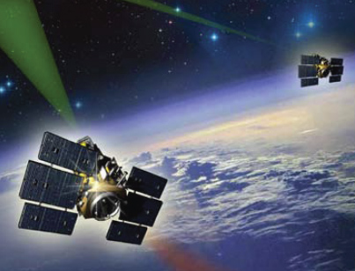
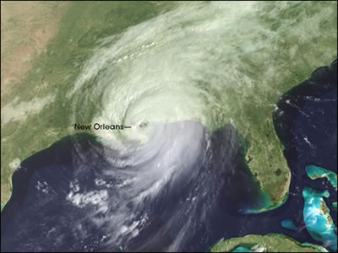
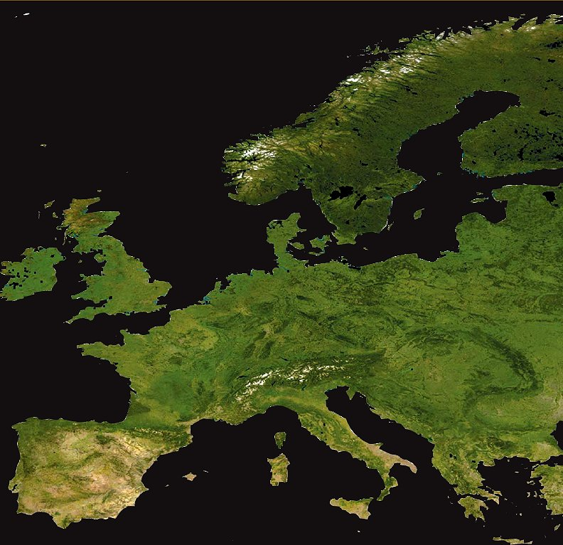
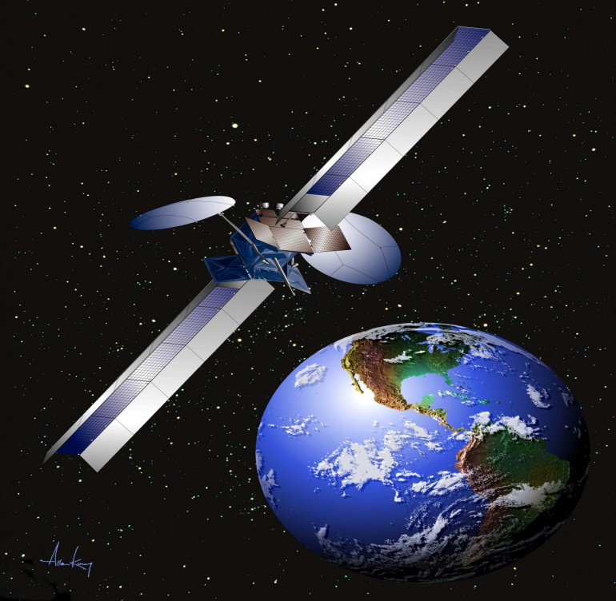
TYPES OF ORBITS -
Uses of Satellites
Daily Uses of Satellites
Big Picture
Affects of Altitude
Notes:
4
4

Slide 67
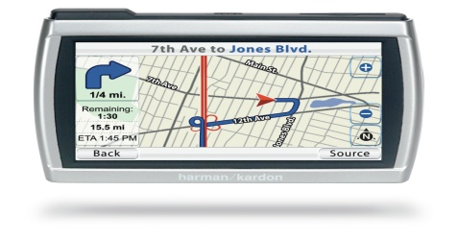
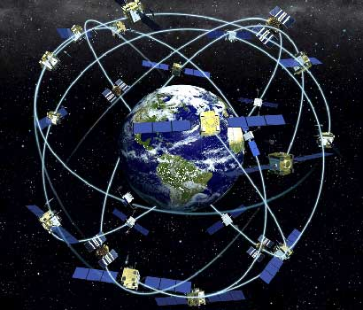
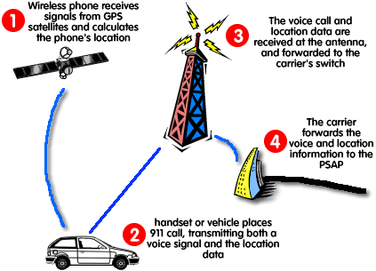
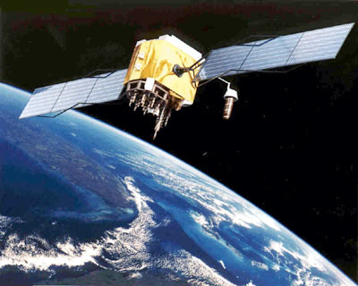
TYPES OF ORBITS -
Uses of Satellites
Global Positioning System!!
Notes:
5
5

Slide 68
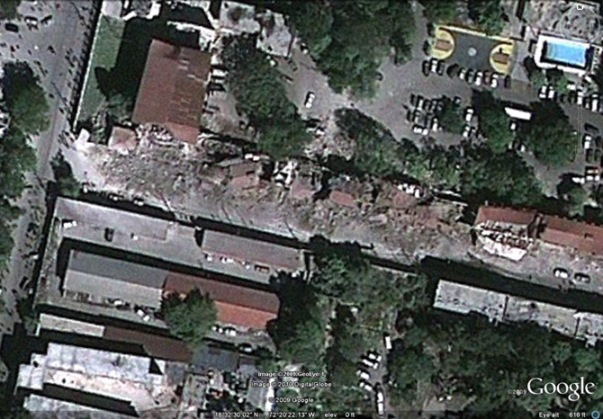
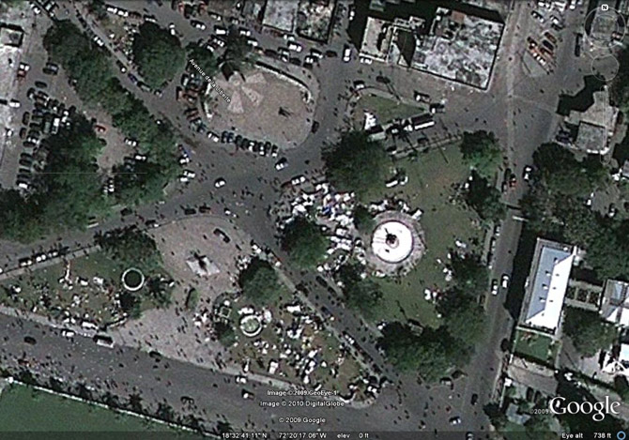
TYPES OF ORBITS -
Uses of Satellites
A Remote Sensing Satellite’s view of Earthquake Damage in Haiti
Notes:
6
6

Slide 69
PLACING SATELLITES IN ORBIT
OVERVIEW
How Satellites are Launched
Location Advantages of the Two Primary US Launch Site
Notes:
3
3

Slide 70
PLACING SATELLITES IN ORBIT
You need LIFT !!
W = m (g)
Weight = mass (acceleration of gravity)
Notes:
4
4

Slide 71
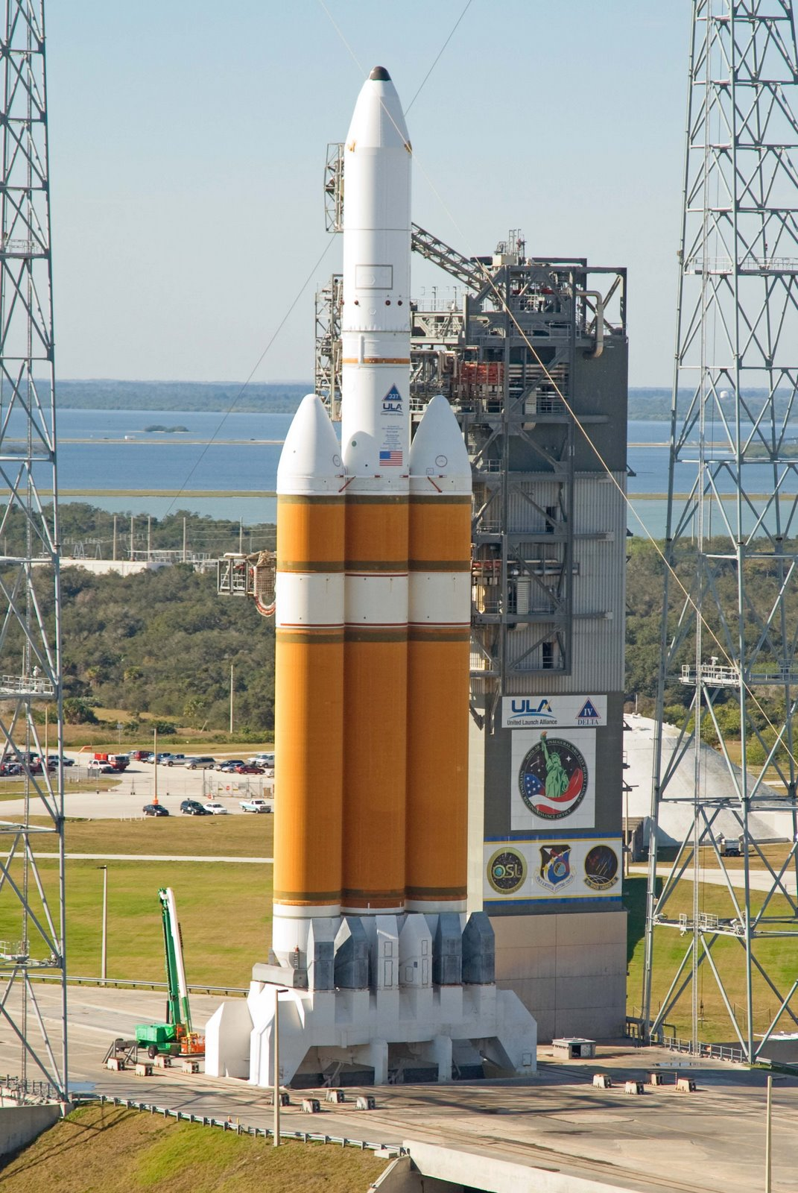
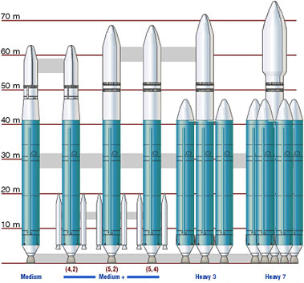
PLACING SATELLITES IN ORBIT
Boosters
DELTA IV
Notes:
5
5

Slide 72
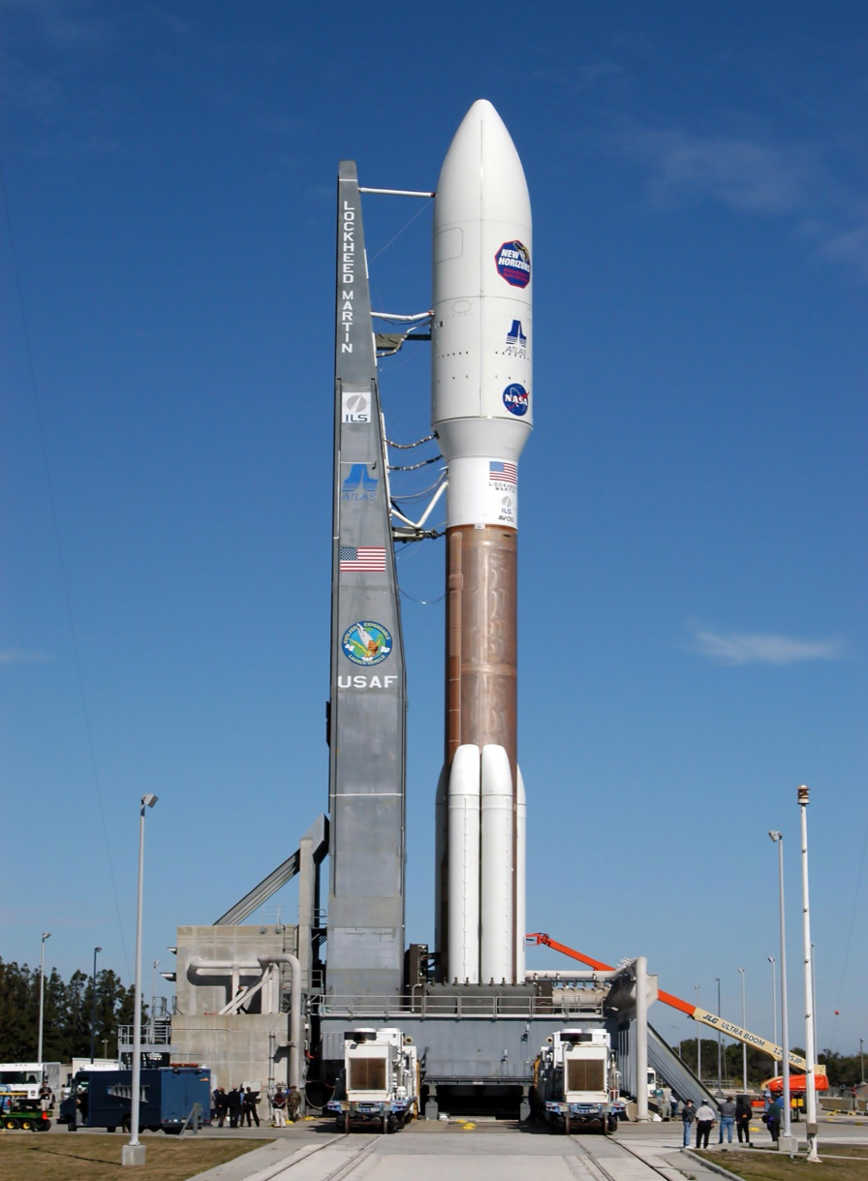
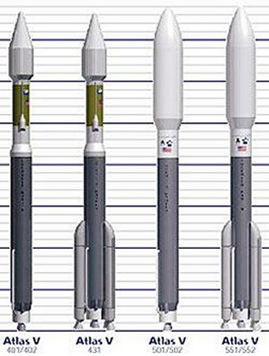
PLACING SATELLITES IN ORBIT
Boosters
ATLAS V
Notes:
6
6

Slide 73
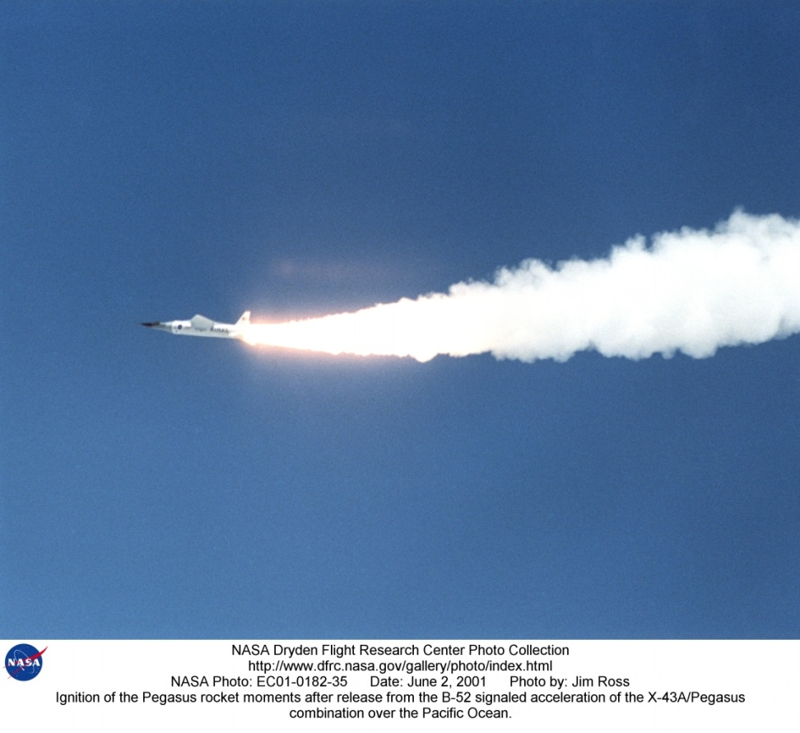
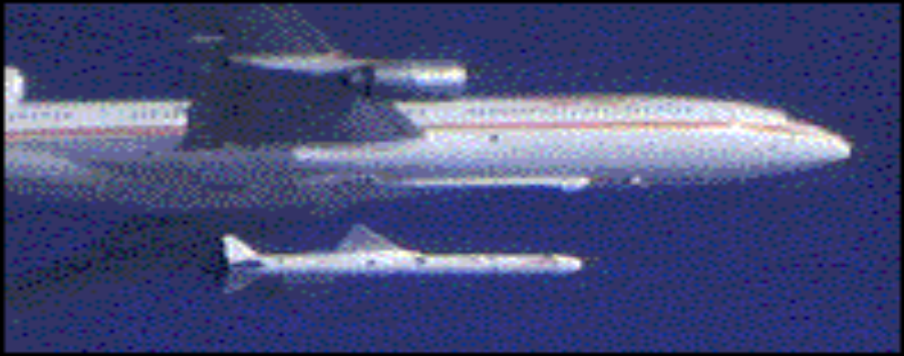
PLACING SATELLITES IN ORBIT
Boosters
PEGASUS
Notes:
6
6

Slide 74
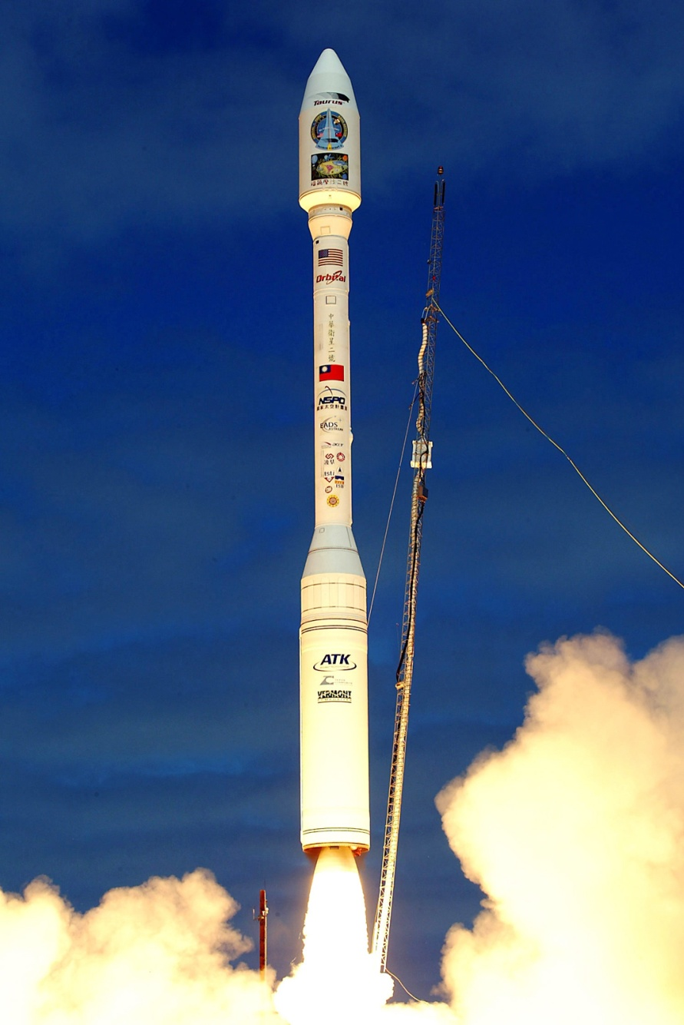
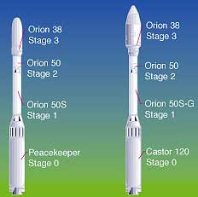
PLACING SATELLITES IN ORBIT
Boosters
TAURUS
Notes:
6
6

Slide 75
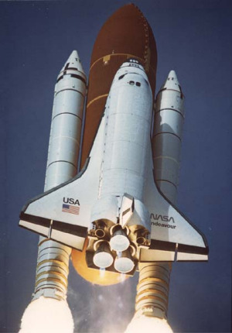
PLACING SATELLITES IN ORBIT
Boosters
The
SHUTTLE
BOOSTER
Notes:
6
6

Slide 76
PLACING SATELLITES IN ORBIT
Launch Locations
  Cape Canaveral (Patrick AFB) Eastern Range)
  Vandenberg AFB (Western Range)
Notes:
6
6

Slide 77
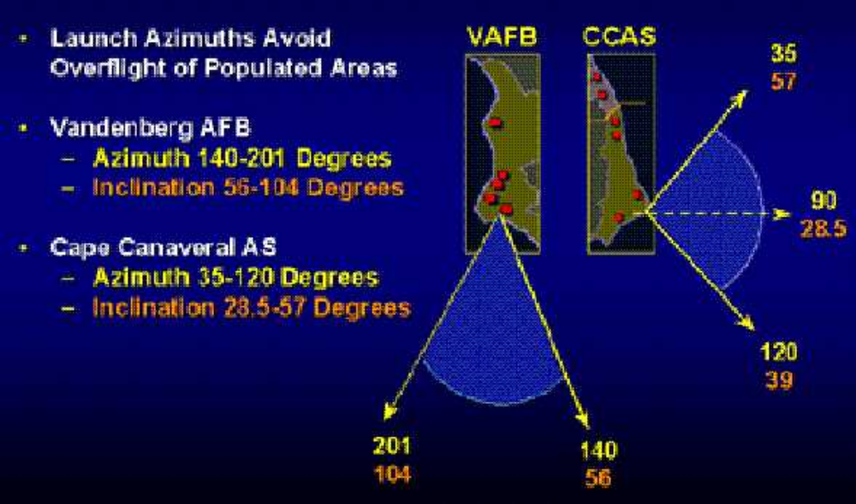
PLACING SATELLITES IN ORBIT
Launch Constraints
Notes:
6
6

Slide 78
SATELLITE OPERATIONS
ELEMENTS
Ground Segment
Space Segment
Data Link Segment
Notes:
4
4

Slide 79
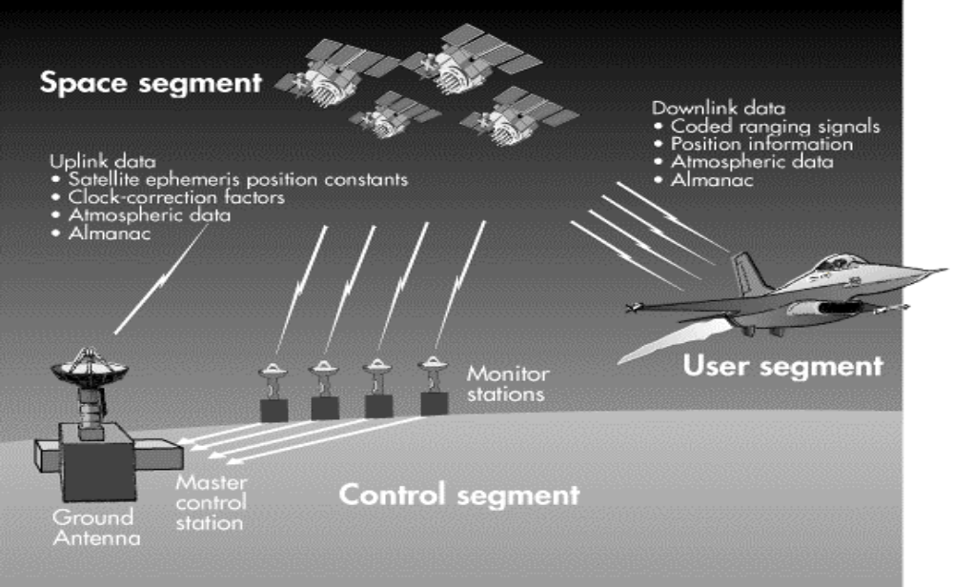
SATELLITE OPERATIONS
FUNCTIONS
GPS Example
Notes:
5
5

Slide 80
SATELLITE OPERATION
ACCESS
Field of View (FOV)
Location of Ground station/Observer
Satellite Orbital Position
Notes:
6
6

Slide 81
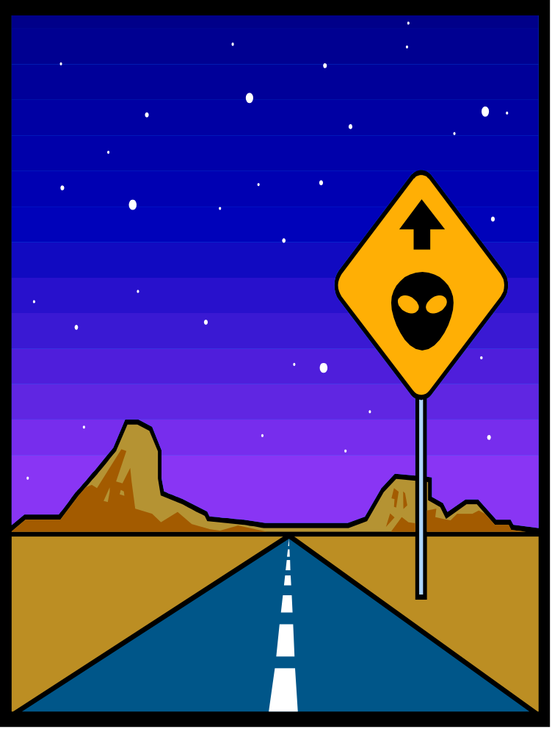

ORBITAL MECHANICS
Classroom Presentations
using Powerpoint
Demonstrate with STK
Let’s Demo !!
The world of Space Operations awaits you!!
Notes:
5
5

